Slide 1
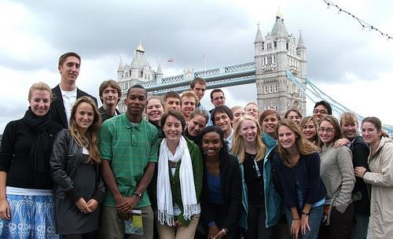
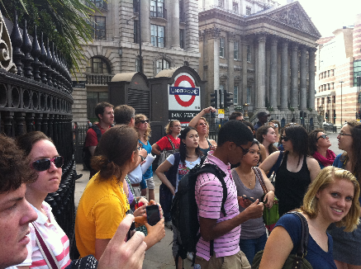
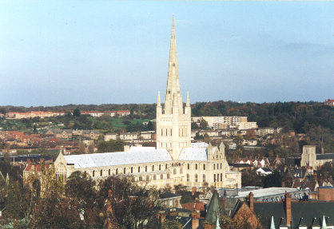
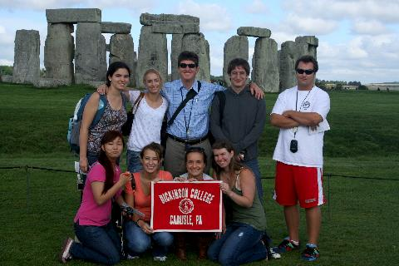
Norwich Science Program
Information Session
Fall/Spring/Year
2017-2018

Slide 2
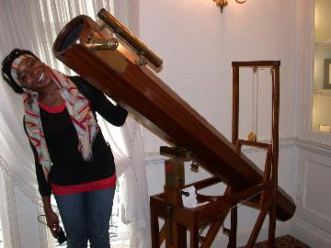

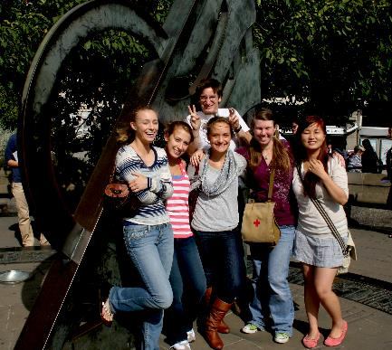
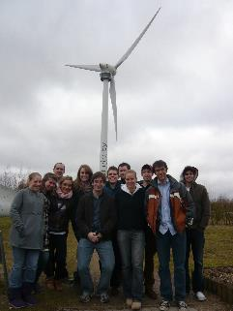
Who Should Go?
Norwich Science Program is appropriate for students studying
Biology, B&MB, Neuroscience
Chemistry
Environmental Science & Studies
Earth Sciences
Mathematics, Computer Science
Psychology
Physics (1 semester only)
Economics
any other subject coupled with an interest in science
Notes:
Econ majors often go on science program.
Possible to take courses toward all of these majors as well as distribution requirements while at UEA
Note: No Physics program – but there are applied physics opportunities.

Slide 3
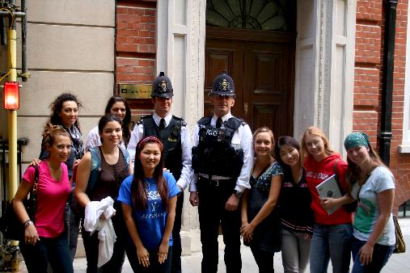
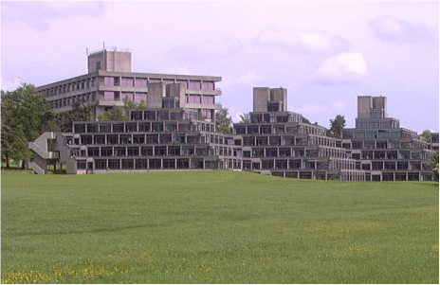
Why Should You Go?
Cultural Experience
See the world and the US from another perspective.
Better understand the impact of science in England on western culture past, present, and future.
Travel
Academic Experience
Experience a top ranked research university
Take advantage of its opportunities
Become a more independent student
Notes:
UEA is ranked in the top one per cent of universities in the world and is consistently in the top ten for student satisfaction.
Has ranked 1st for student satisfaction, accommodation quality and cost by students.
90% of research at UEA has been rated of “international Excellence”
Geosciences – 3rd in the world
Environmental Studies, Biological Sciences, Chemistry, Mathematics, Social Work – Ranked “at 5” the highest ranking
Climatic Research Center – touted as the “strongest in the world”
Field Courses – take advantage of location
More Course Variety – take advantage of size

Slide 4
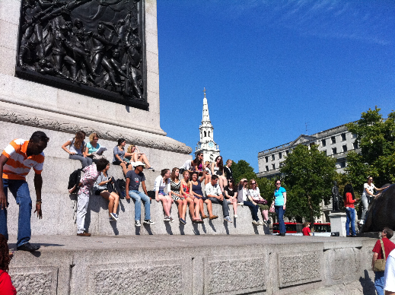
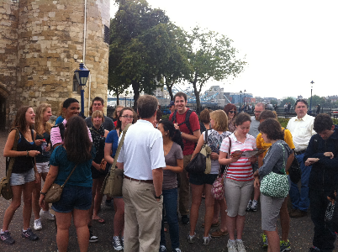
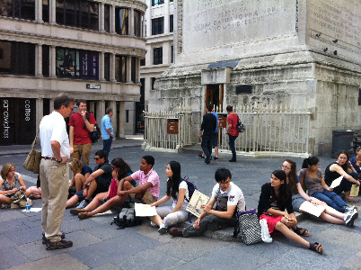
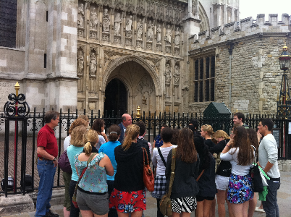
When Can You Go?
Norwich Science Program offers
Fall Only
Spring Only
Full Year
Typically during the junior year
Notes:
Offers the flexibility needed to work with science majors.
Full year:
Broader range of courses because some courses can only be taken for the full year.

Slide 5
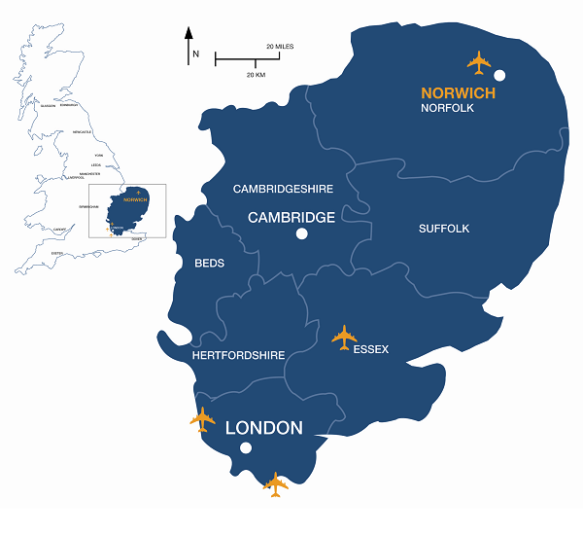

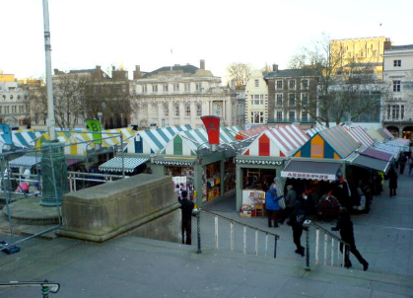
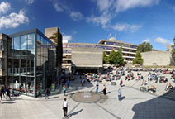
Where Will You Be?
UEA is in the City of Norwich in Norfolk County in the East Anglia Region

Slide 6
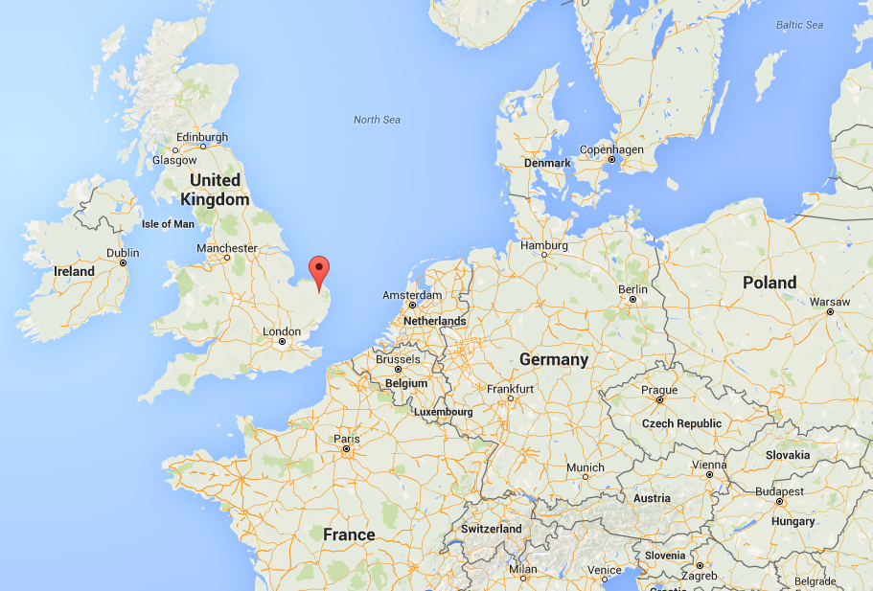
Where is Norwich?

Slide 7
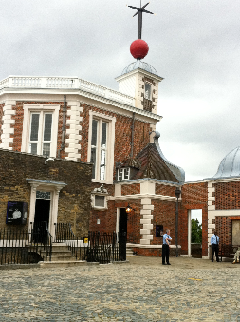
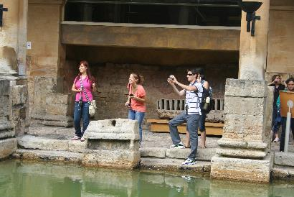
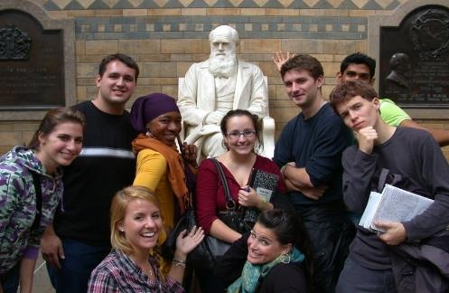
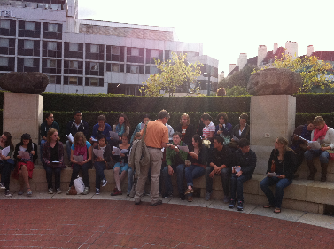

What Will You Do?
Fall Term
History of Science
2.5 weeks in London and surrounds
0.5 week excursion
Fall 2016, likely
Bath/Stonehenge
3 Courses at UEA
Notes:
Visits probably include: British Library, the Royal Society, the Royal Observatory at Greenwich, the Royal Pharmaceutical Society Museum, the Freud Museum, the Natural History Museum, the Linnean Society, the Royal Institution, London Science Museum, Bletchley Park

Slide 8
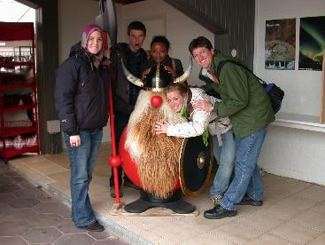
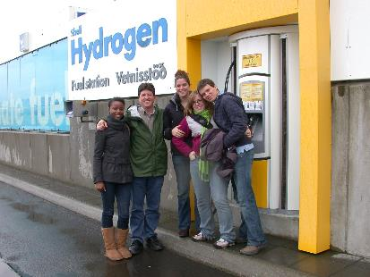
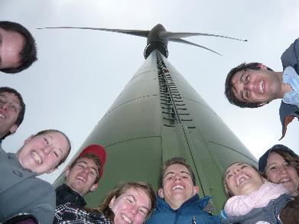
What Will You Do?
Spring Term
Science and Society
1-week course-connected excursion (e.g. London and Stockholm)
3 Courses at UEA
Considerable opportunities for independent travel

Slide 9
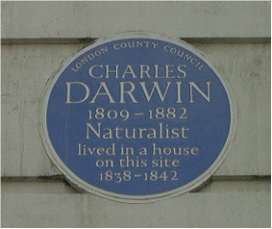
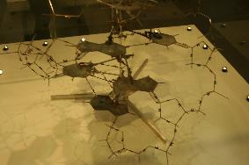
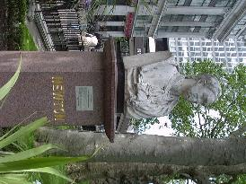
What Will You Study?
Courses can count toward majors/minors and distribution requirements. A few examples:
The Enlightment
The Renaissance
Postcolonialism
Comedy and the Absurd Theatre
Theatre, Tradition, and Social Change
Evolutionary Psychology
Evolution, Behavior and Ecology
Evolutionary Biology
Molecular Biology
Cell Biology
Computer Networks
Computational Linguistics
Combinatorics
Atmospheric Physics and Weather Forecasting
Environment and Society
Low Carbon Energy Resources
Global Environmental Change
Developmental Psychology
Gender: Psychosocial Perspectives
The Child in Society
The Child Care Professional
Approaches to Counseling Psychology
Criminology
Notes:
Just some sample courses.

Slide 10
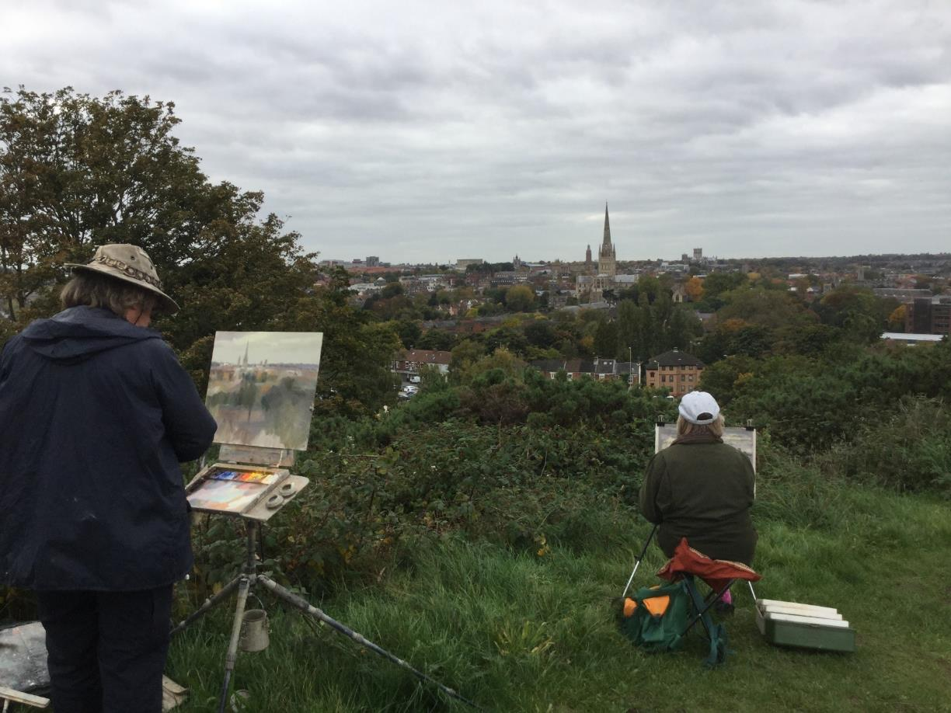
What is it like in Norwich?
Notes:
Just some sample courses.

Slide 11
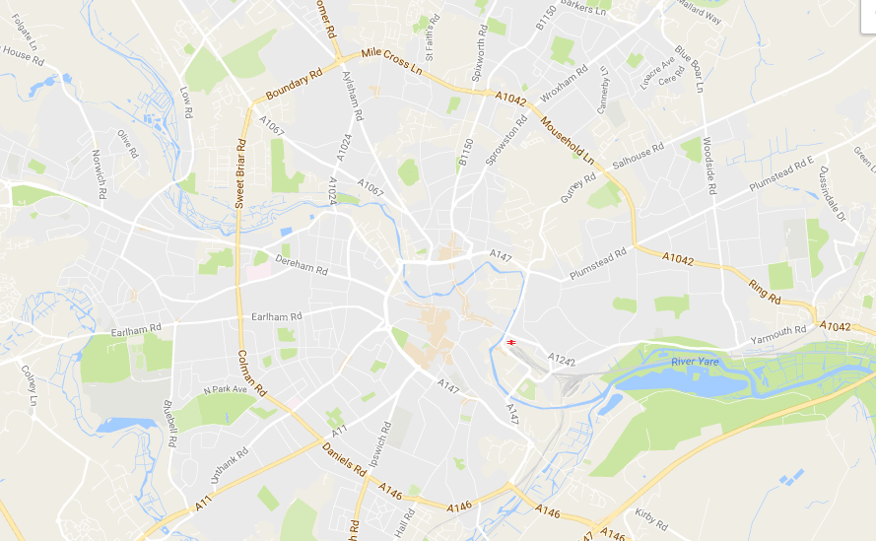
What is it like in Norwich?
Population: 130,000
(200,000 in greater Norwich)
River Wensum
Historic City Center
University of East Anglia
Director’s house
Notes:
Just some sample courses.

Slide 12
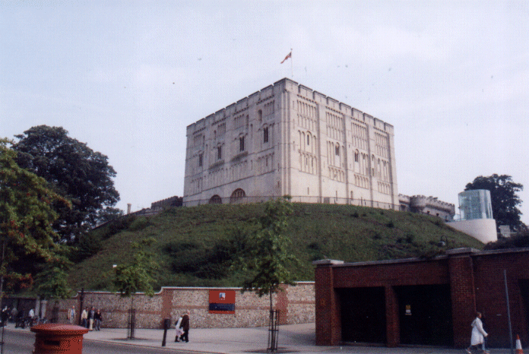
What is it like in Norwich?
The Historic City Center
Norwich Castle
Notes:
Just some sample courses.

Slide 13
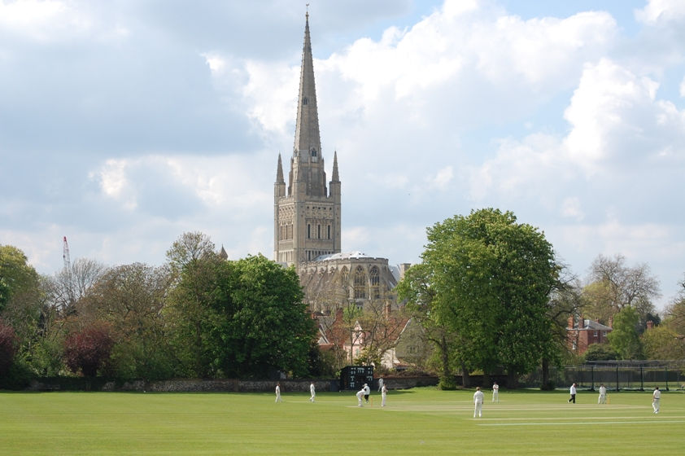
What is it like in Norwich?
The Historic City Center
Norwich Cathedral
Notes:
Just some sample courses.

Slide 14
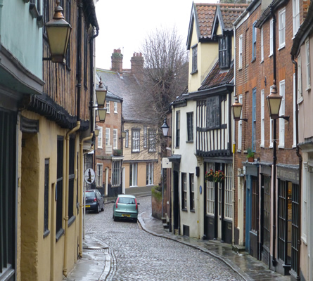
What is it like in Norwich?
The Historic City Center
Notes:
Just some sample courses.

Slide 15
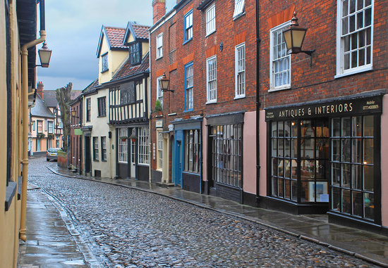
What is it like in Norwich?
The Historic City Center
Notes:
Just some sample courses.

Slide 16
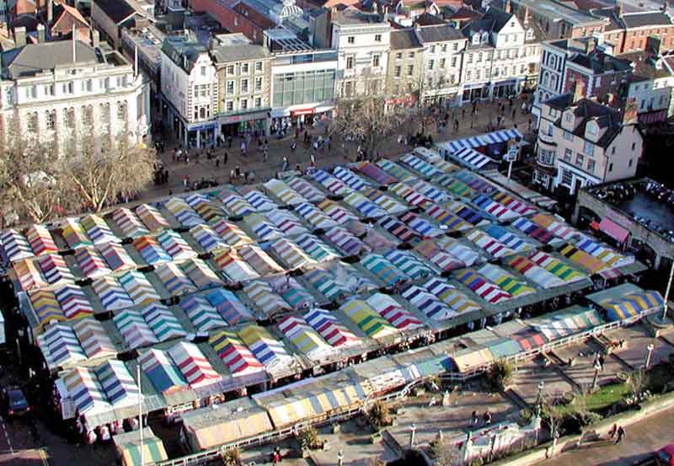
What is it like in Norwich?
The Historic City Center
Notes:
Just some sample courses.

Slide 17
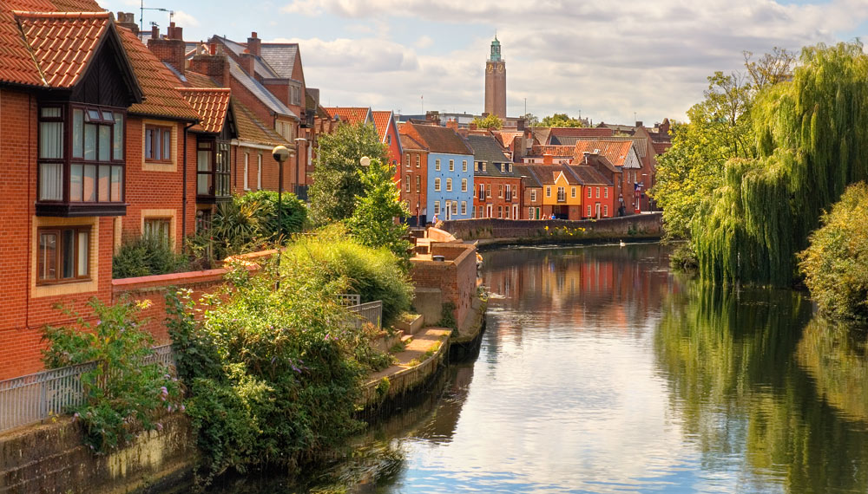
What is it like in Norwich?
The River Wensum
Notes:
Just some sample courses.

Slide 18
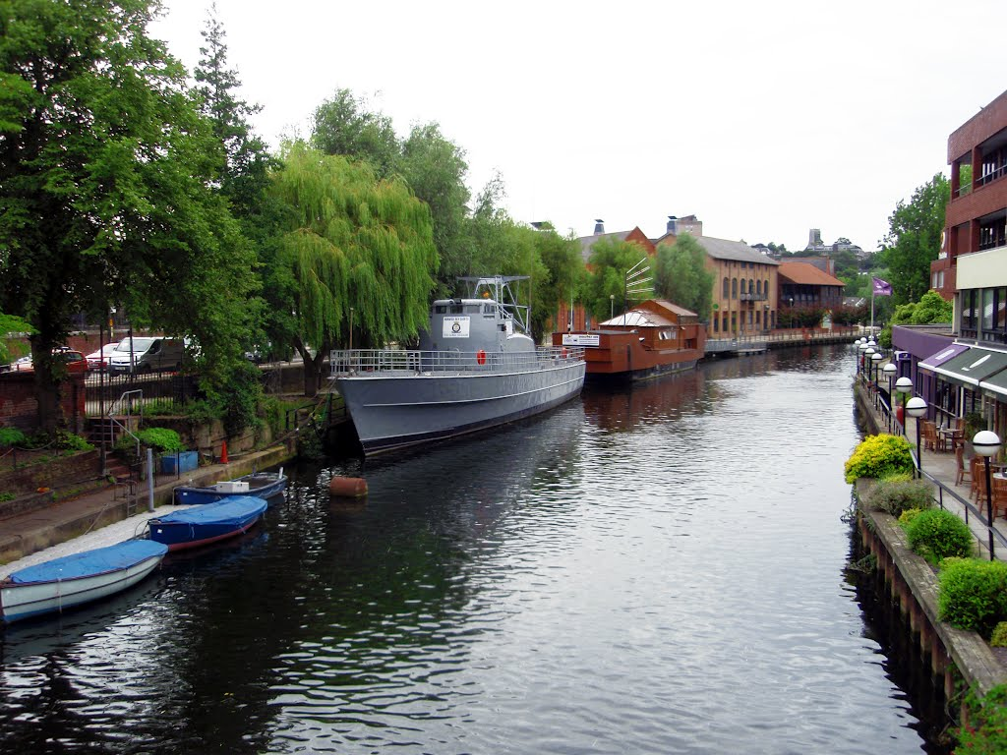
What is it like in Norwich?
The River Wensum
Notes:
Just some sample courses.

Slide 19
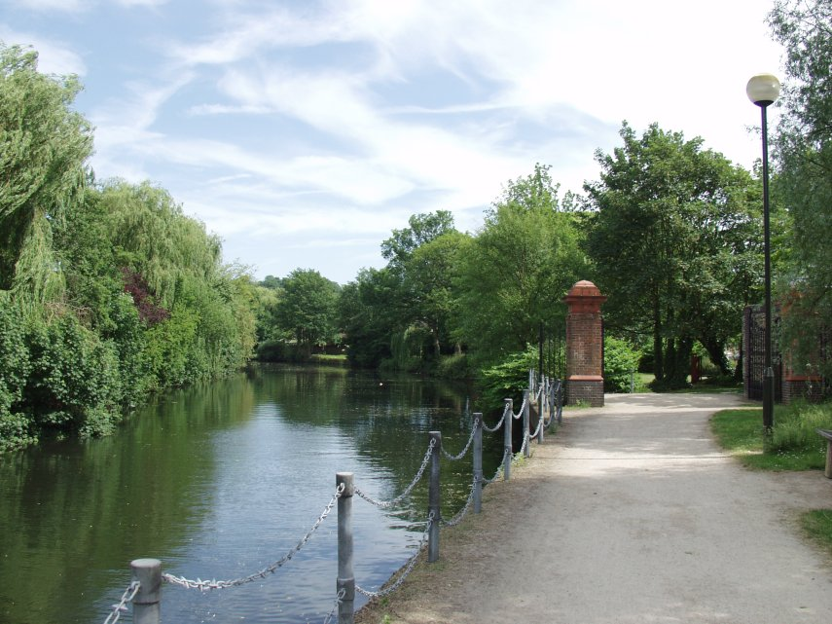
What is it like in Norwich?
The River Wensum
Notes:
Just some sample courses.

Slide 20
What is it like in Norwich?
River Wensum
Historic City Center
20 minute bus ride
University of East Anglia
Director’s house
Notes:
Just some sample courses.

Slide 21
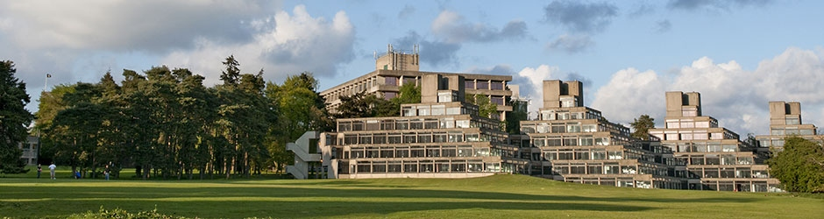
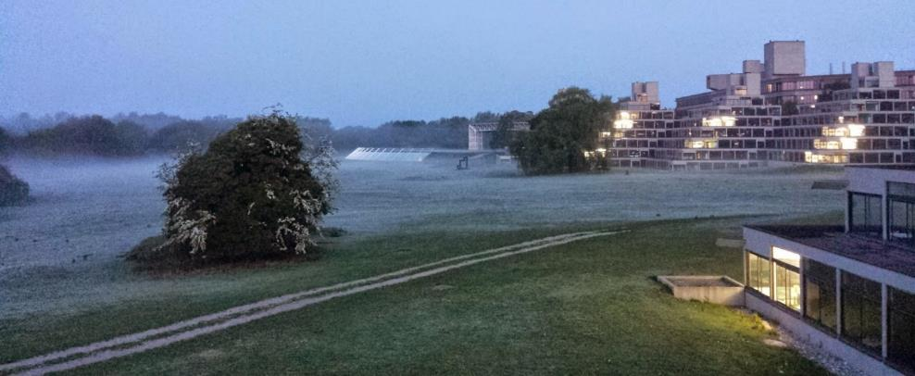
What is it like in Norwich?
University of East Anglia
Notes:
Just some sample courses.

Slide 22
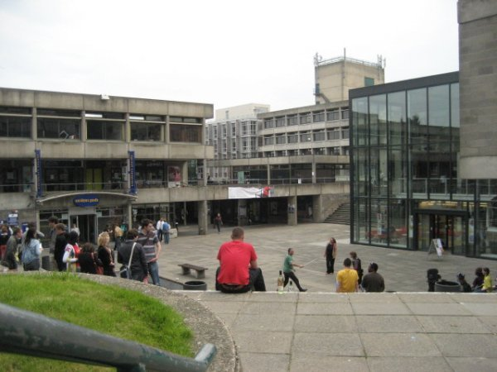
What is it like in Norwich?
University of East Anglia
Notes:
Just some sample courses.

Slide 23
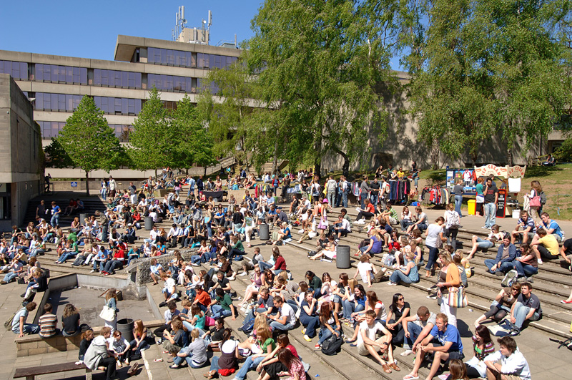
What is it like in Norwich?
University of East Anglia
Notes:
Just some sample courses.

Slide 24
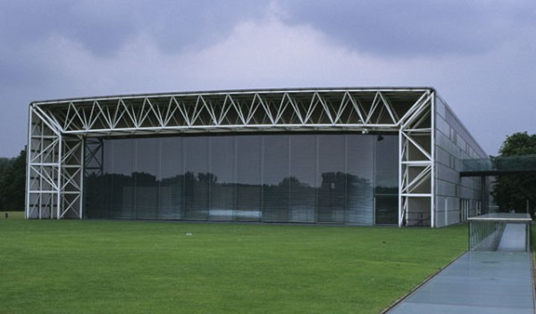
What is it like in Norwich?
University of East Anglia
Sainsbury Center for Visual Arts
Notes:
Just some sample courses.

Slide 25
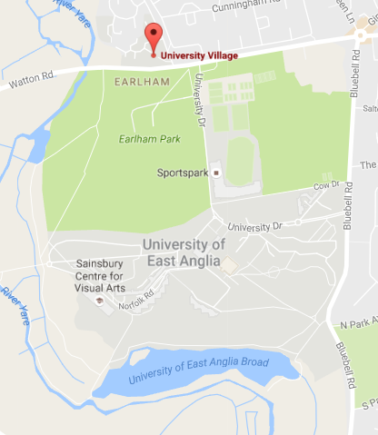
What is it like in Norwich?
accommodation
University of East Anglia
10-15 minute walk
to campus
city
center
Notes:
Just some sample courses.

Slide 26
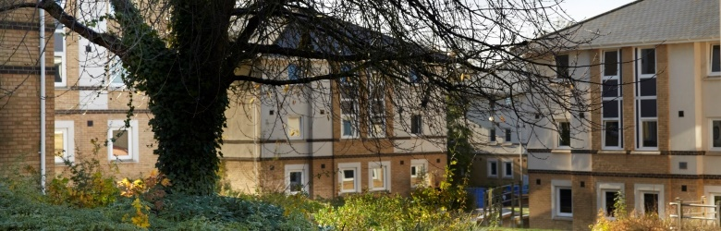
What is it like in Norwich?
University of East Anglia
“The Village”
Notes:
Just some sample courses.

Slide 27
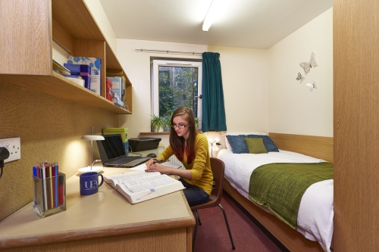
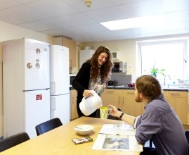
What is it like in Norwich?
University of East Anglia
“The Village”
Single, en-suite rooms…
…with shared kitchen facilities
Single, en suite rooms…
Notes:
Just some sample courses.

Slide 28
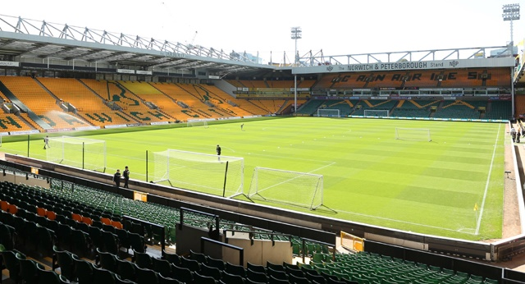

What is it like in Norwich?
River Wensum
Historic City Center
University of East Anglia
Norwich City Football Club
Director’s house
Notes:
Just some sample courses.

Slide 29
Get Planning!
Learn More
http://www.dickinson.edu/global
Talk with your academic advisor(s)
Talk with your family
Talk with me
Prof. John MacCormick
Tome 242 x1626 jmac@dickinson.edu
Deadline for Fall 2017: 2/15/17 (4th week of spring semester)

